Slide 1
Potential Usability Issues with New Website
Existing users will notice the interface is different and has changed, which may result in frustration and confusion, and potentially a lost user. (permanent)
Users may be used to the current navigation and journey flow of accessing information, and if we change it, we will need to do so in a way that uses the same verbiage or imagery as the current one to make it easy to find. (temporary)
Elderly people don’t like to feel they are old or out of touch with new technology, so they might feel embarrassed if they can’t figure out how to use the new website. This could result in a user who won’t even want to try using the new website. (permanent)

Slide 2
Strategy for Solving Potential Issues w/ New AEAC Website
Creating a new website experience building off of a current one can be tricky, but starting with a flow that is inspired by a target user persona is a good place to start. This means that we follow a hypothetical user’s linear task flow and flow chart. Our audience might experience some initial shock when they see the interface of the new homepage, but we can create prototypes of the new design, and test usability with people to get a clear picture of how they will actually react to the change. Specifically, with our user story map, we can articulate the jobs to be done by our target user and get feedback on if they were able to accomplish them, and in how much time. We need to collect subjective and objective feedback on the prototypes in order to get a realistic view of if our target users will adapt or abandon the new flow based on emotion and efficiency.
This strategy is a cost and time efficient way to give us insights on where the pain points are, and potentially uncover enhancements we may not have anticipated that will delight users! If we strategize approaching the new design in this way, it will provide us with data we need to resolve the potential issues users may face to create a truly optimized design.

Slide 3
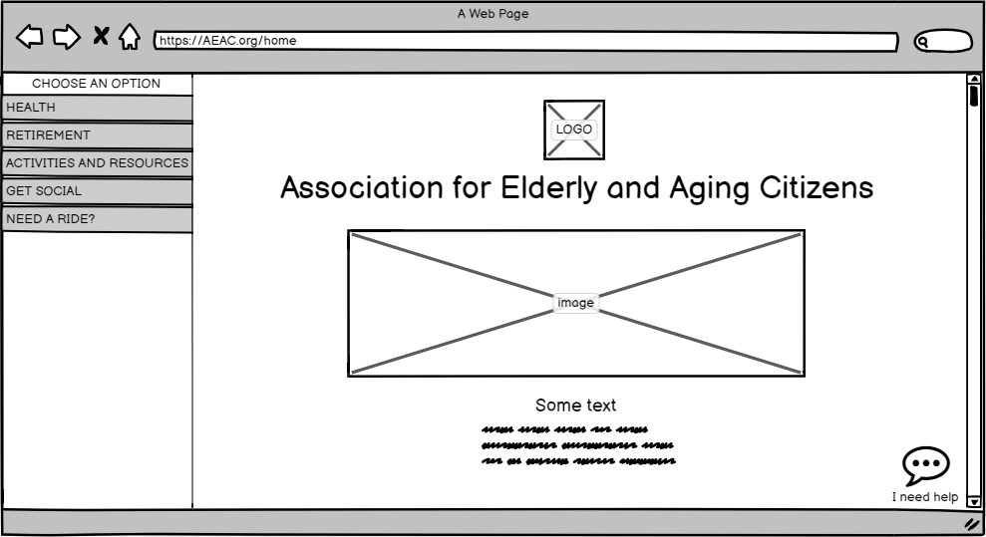
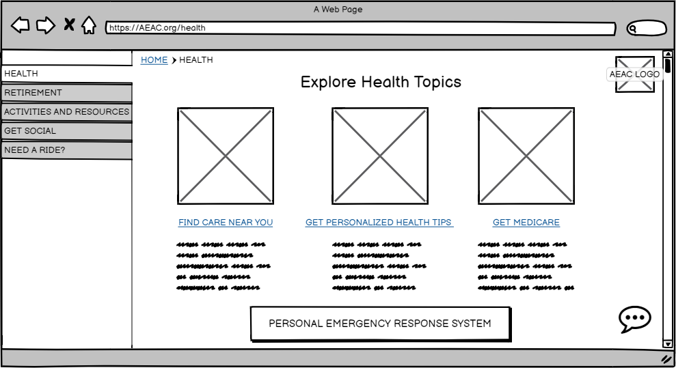
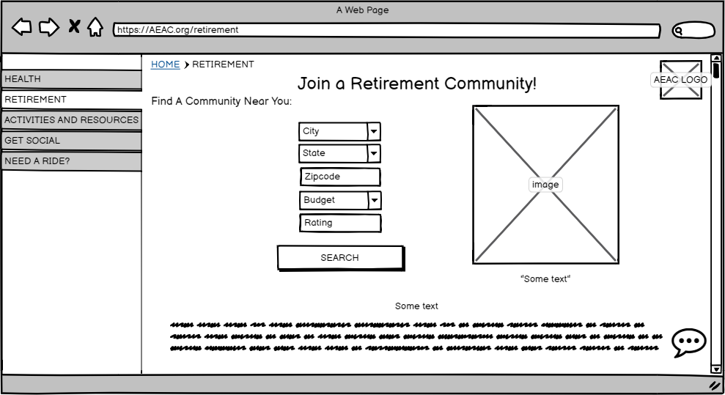
Balsamiq Wireframe - Pages 1-3 https://balsamiq.cloud/selqmg4/puogdi6
Low Fidelity

Slide 4
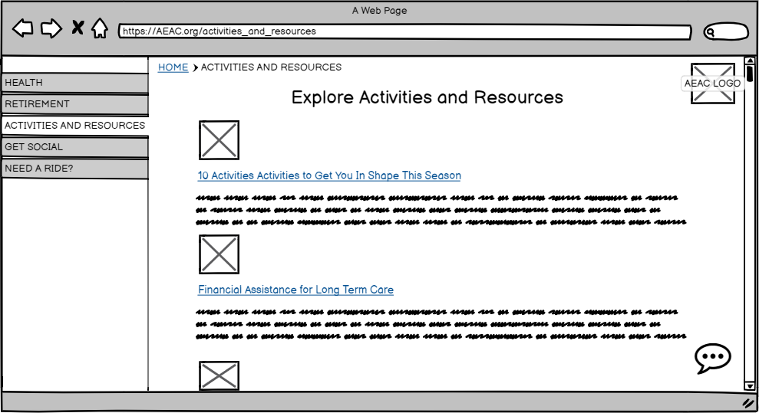
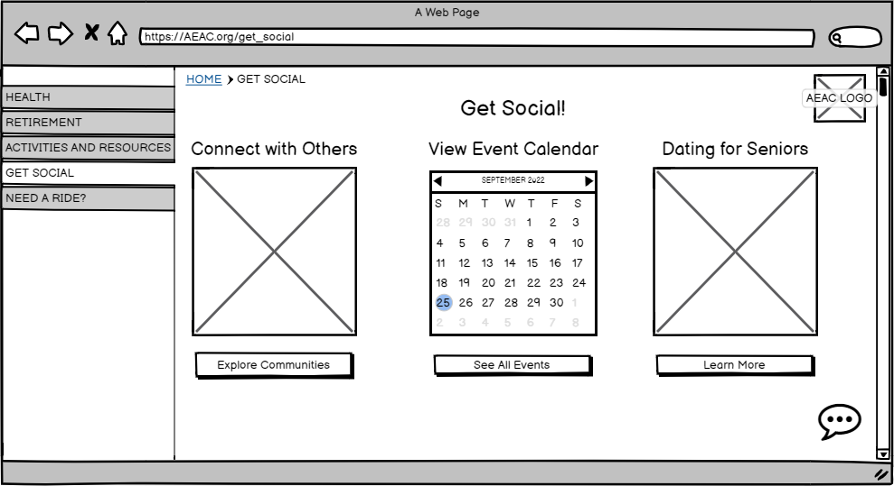
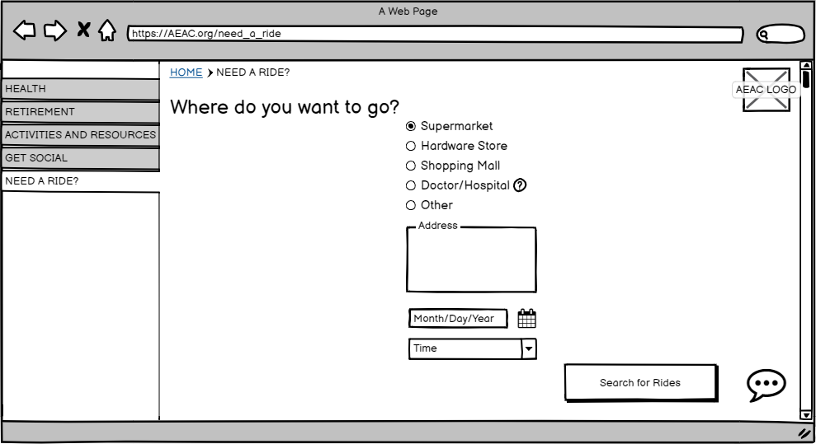
Balsamiq Wireframe - Pages 4-6 https://balsamiq.cloud/selqmg4/puogdi6
Low Fidelity

Slide 5
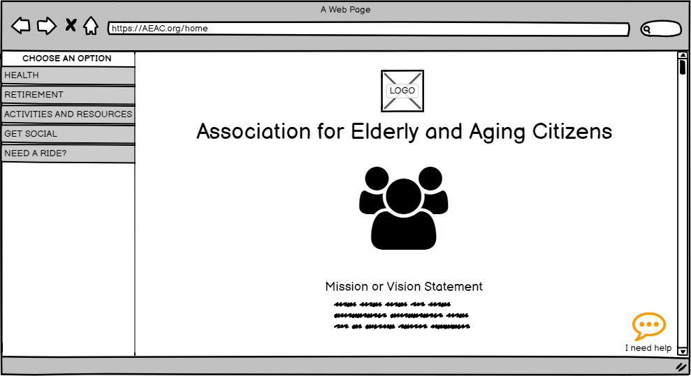
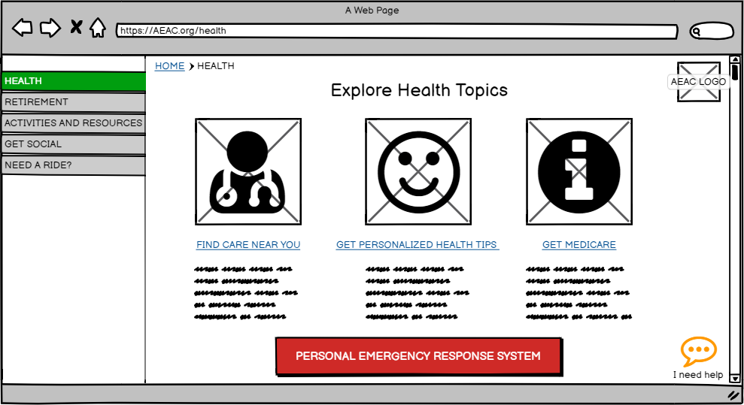
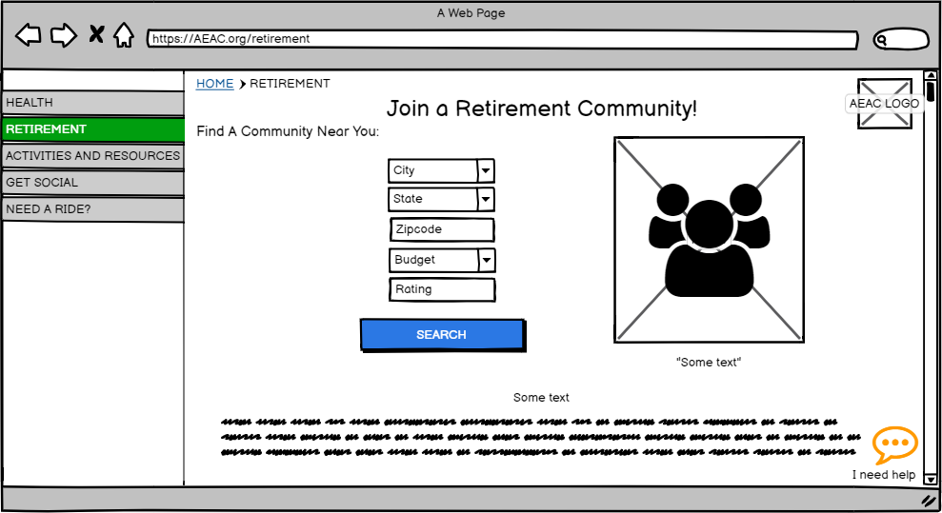
Balsamiq Wireframe - Pages 1-3 https://balsamiq.cloud/selqmg4/puogdi6
Iterations/Updates

Slide 6
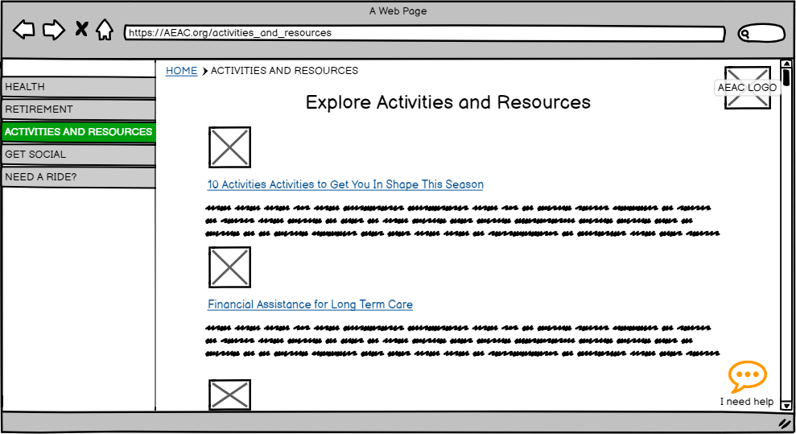
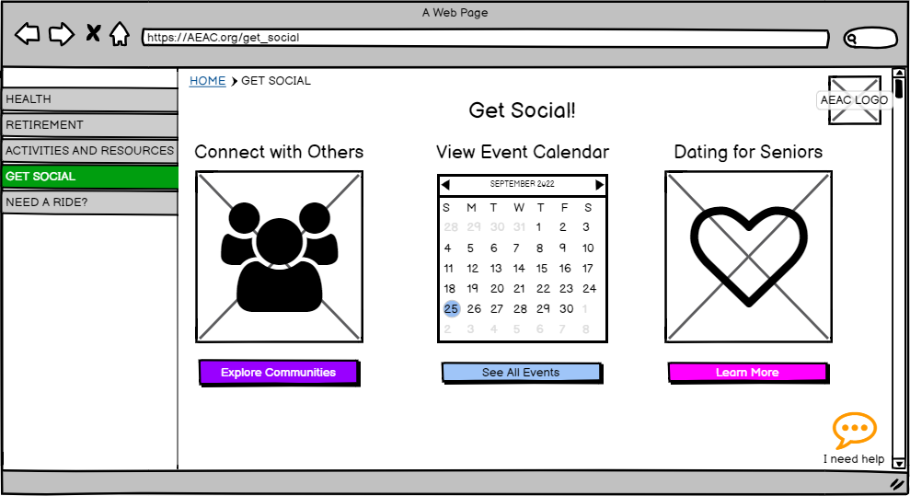
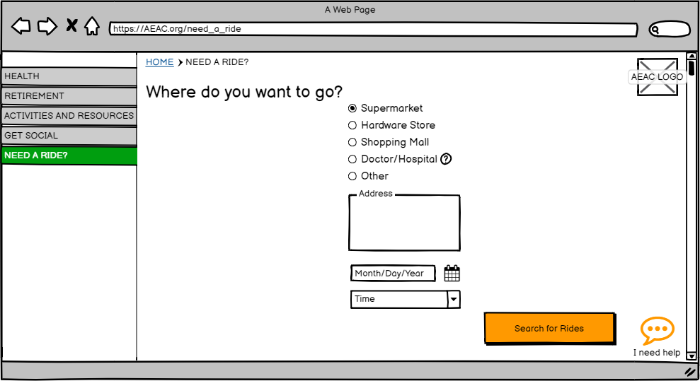
Balsamiq Wireframe - Pages 4-6 https://balsamiq.cloud/selqmg4/puogdi6
Iterations/Updates

Slide 7
AEAC New Site Prototype - Invision
https://zararahman16608.invisionapp.com/console/share/PY7UCRWEDHK/956874705
Begin on the home screen landing page. This will inform you that you are on the Association for Elderly and Aging Citizens website
Navigate to the left hand side for an overview of topics to explore (Health, Retirement, Activities and Resources, Get Social, Need A Ride?)
Click on any of the topics to explore one
Click on “home” on the top left of each screen to navigate back to the home screen landing page
Toggle between each tab on the left to navigate to different topics
Click the back arrow on the top left of the screen to go back to the previous page you were on
Click the forward arrow on the top left of the screen to move forward to the next topic

Slide 8
User Testing Plan
Contextual Inquiry Product Assessment is the appropriate method for user testing on this prototype
We can assess how our elderly users are interacting with the service during their everyday lives
This method will give us an accurate and realistic view of how user friendly and impactful the service is in our target user’s every day life depending on their goals
We can measure the following:
Satisfaction with the Need A Ride service (functionality, efficiency)
Satisfaction with connecting elders to each other (online communities and in person meet ups)
Satisfaction with informing elders about their health care options and other various health topics
Website is easy to use and navigate
Services are comprehensive of anything an elderly or aging citizen might inquire about in one website

